Slide 1
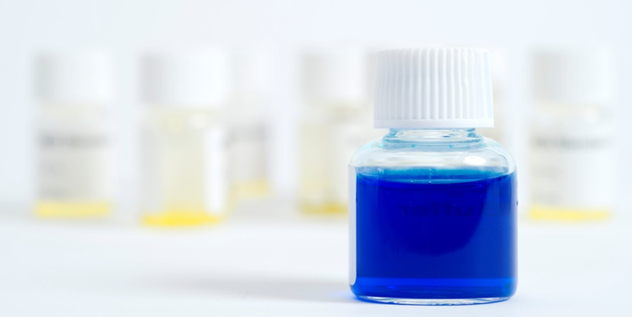
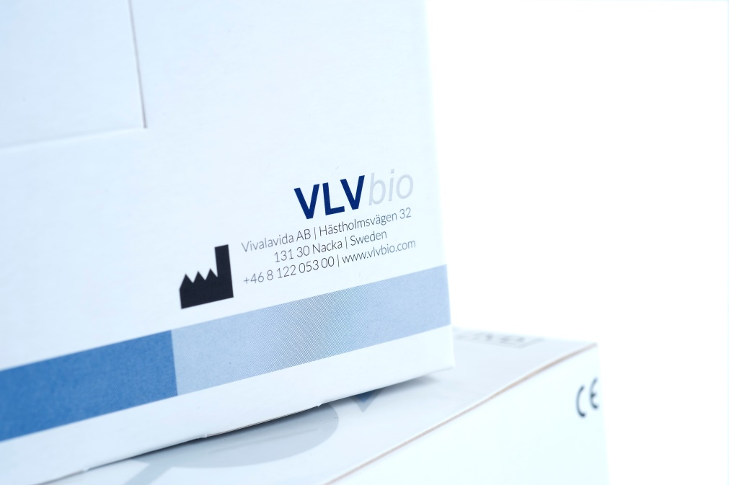
DiaPharma Group, Inc.
We specialize in biomarkers for toxicology (drug-induced liver and kidney injury), liver disease, oncology, and hemostasis
Featured Products are K18 biomarkers from VLVBio AB
VLVbio AB combines the innovative will and energy of a company founded in 2013 with the history and built-in expertise of a Product Line invented more than a decade ago at the Karolinska Institute in Stockholm, Sweden.
Bringing innovative high-quality biomarker assays to DILI research.

Slide 2
Biomarkers of Drug-Induced Liver Injury
Normal liver function
Early detection biomarkers
K18, ccK18, Osteopontin, L-FABP, α-GST
Standard biomarkers
ALT, AST
Liver function
Standard biomarkers
ALP, Bilirubin
Increased risk of liver damage
Liver damage
Decreased liver function
Time/ Drug-induced liver injury

Slide 3
Biomarkers of Drug-Induced Kidney Injury
Normal kidney function
Early detection biomarkers
NGAL, L-FABP, α-GST, Cystatin C
Glomerular filtration rate
Standard biomarkers
Scr, BUN, urine output
Increased risk of kidney damage
Decreased kidney function
Time/ Drug-induced kidney injury

Slide 4
Use of new biomarkers
Featuring Keratin 18
Increase tissue specificity
Provide mechanistic information
Predict liver injury at earlier time points than ALT
Current uses:
  K18 as a secondary level of investigation if the first biomarkers indicate liver issues
    Company has already identified a potential liver signal and is trying to gain some mechanistic understanding about the signal. (eg, observed elevated ALT to determine if the injury is primarily necrotic or apoptotic)
  K18 as a first line in cases where liver toxicity is a known issue
    (ie, immuno-oncology drug investigations)

Slide 5
Keratin 18 in the human body
Almost all cells of epithelial origin:
Liver
Lung
Intestines
Kidney
Breast tissue
Prostate
Ovary
- Brain/CNS/ Neurons
- Skin
- Muscles
- Connective tissue
- Bone marrow
- Blood

Slide 6
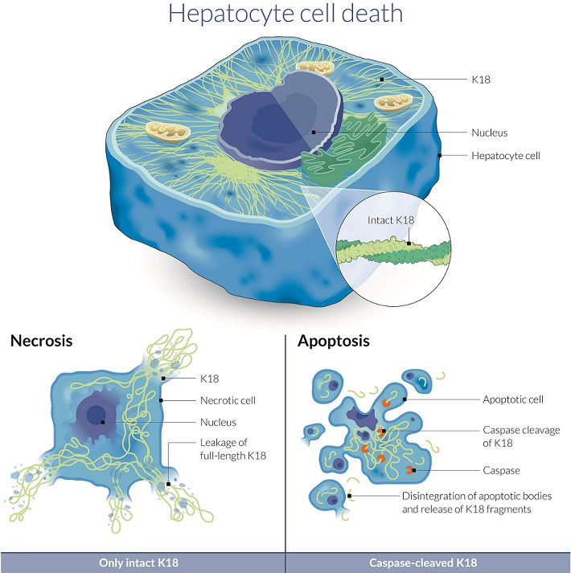
Apoptosis and Necrosis – K18

Slide 7
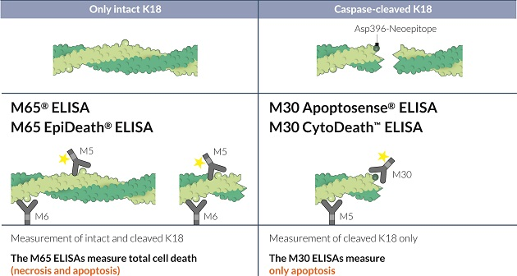
Apoptosis and Necrosis

Slide 8
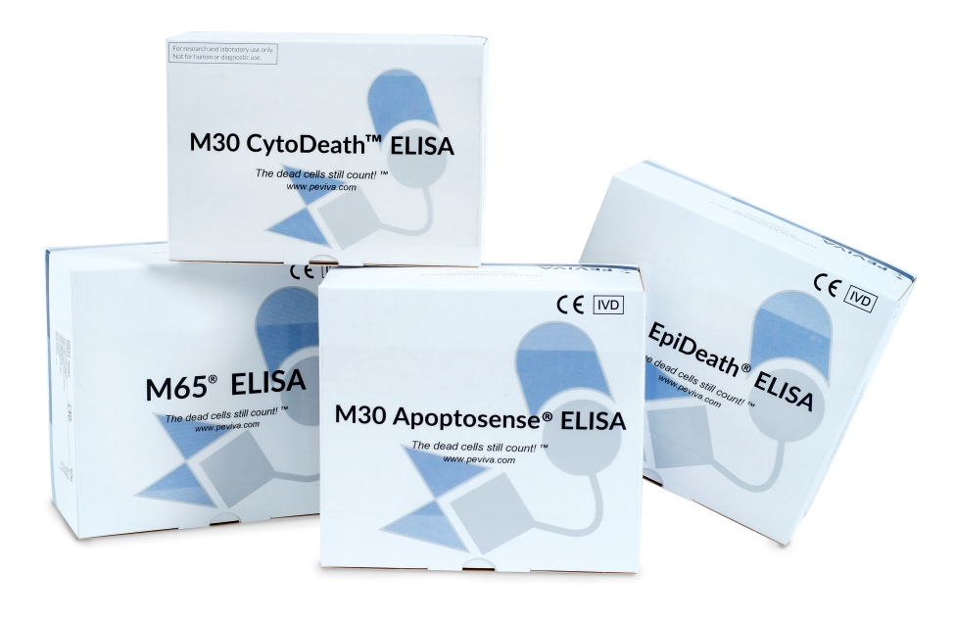
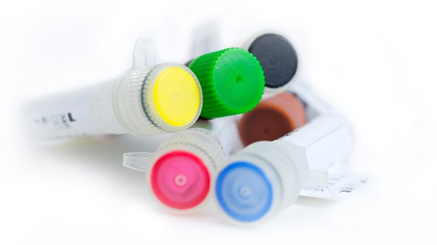
PEVIVA Product Line
Overview
ELISA Products
M30 Apoptosense® ELISA
M30 CytoDeath™ ELISA
M65® ELISA
M65 EpiDeath® ELISA
Antibody Products
M30 CytoDEATH ™ mAb
M6 & M5 Keratin 18 mAb

Slide 9
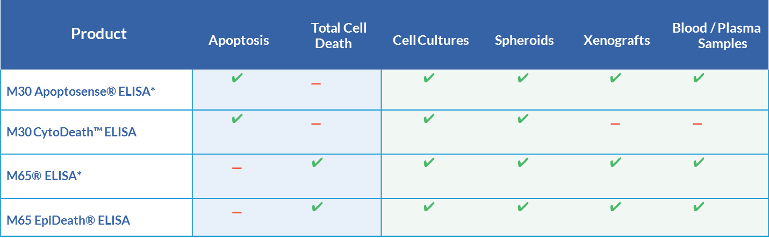
PEVIVA Product Line
Overview

Slide 10
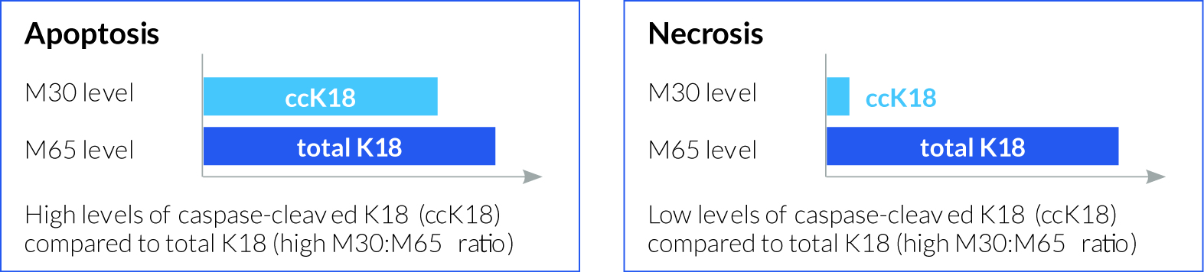
PEVIVA Product Line
Determination of Cell Death Mode
Products can be useful to quantify:
  Apoptosis alone (M30)
  Total cell death (M65)
  Apoptosis and necrosis (M30 and M65)

Slide 11
Drug-Induced Liver Injury Biomarker
Numerous ongoing research for use of K18 in DILI
Letters of Support – EMA and FDA: Keratin 18 and Osteopontin
Comparison to traditional biomarkers (ie, ALT) with APAP or exercise
Drugs (ie, Heparins) showing elevations in ALT/AST, miR-122 without presence of clinically significant liver injury
Drugs meeting stopping criteria as outlined by FDA for potential hepatotoxicity may not results in serious liver injury with use of new biomarkers and mathematical modeling (ie, Cimaglermin alfa)
Toxicant-Associated Steatohepatitis (TASH)
Alcohol related liver damage
→ All of the above research studies using human samples. Previous K18 biomarkers did not detect mouse or rat K18 resulting in limitations in various preclinical models

Slide 12
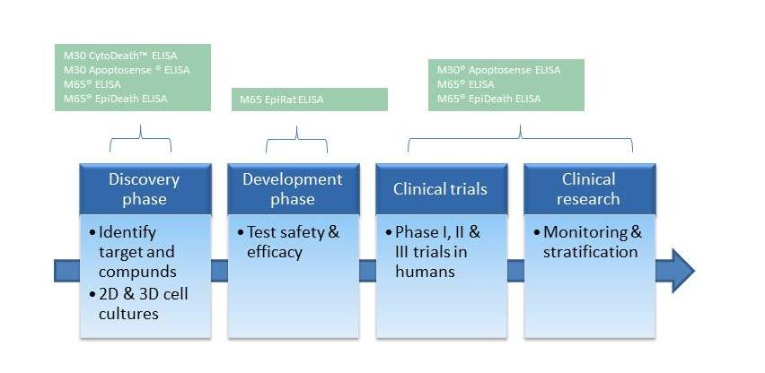
Introduction of M65® EpiRat ELISA

Slide 13
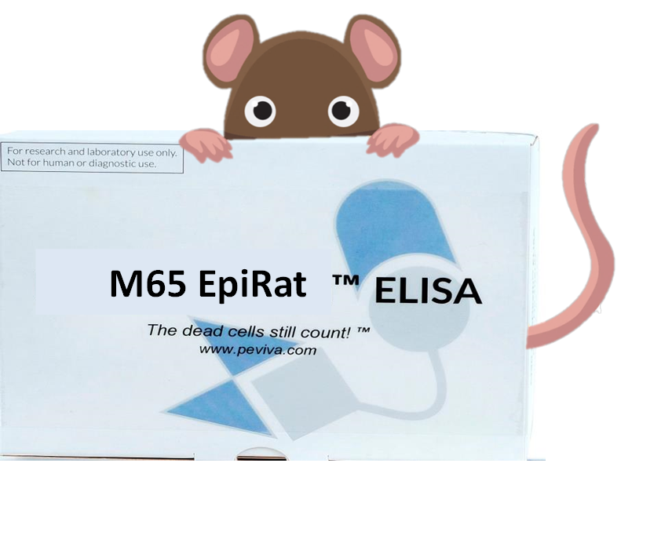
M65® EpiRat ELISA
Production of the new rodent-detecting antibody (monoclonal).
95 clones selected after mice immunization, 7 clones selected for further testing.
Only rat, does not detect K18 from mouse!
M65 EpiRat is born!
The M65 EpiRat™ ELISA is based on the M5 and M6 antibodies, which bind to the biomarker Keratin-18 (K18). The concentration of K18 reflects the amount of overall cell death, both apoptosis and necrosis, in K18 positive cells. Levels of K18 are commonly elevated when the liver endures damage, through disease or toxicological effects.

Slide 14
M65 EpiRat™ ELISA treated with Acetaminophen
Serum samples from untreated rats and rats treated with different doses of APAP were run using the M65 EpiRat™ ELISA. Below you can see results from two runs where rats treated with 1000mg/kg APAP and 1500mg/kg APAP compared to untreated controls. Blood was drawn after 0, 24, and 48 hours.

Slide 15
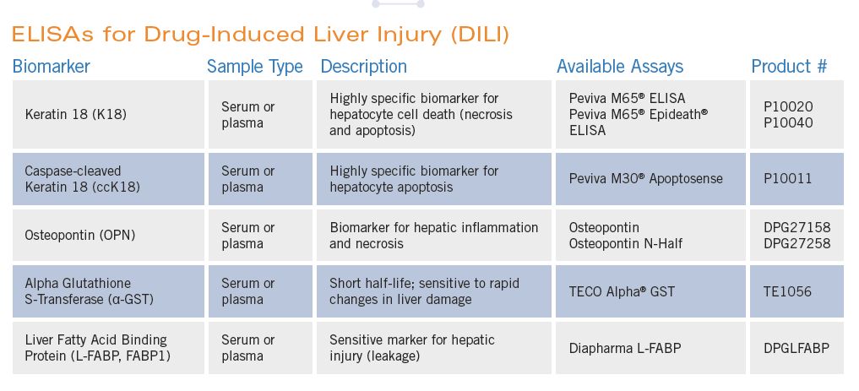
ELISAs for Drug-Induced Liver Injury (DILI)

Slide 16
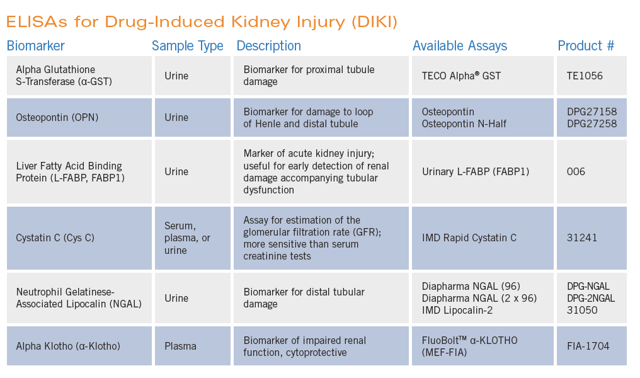
ELISAs for Drug-Induced Kidney Injury (DIKI)

Slide 17
Questions?

