Slide 1
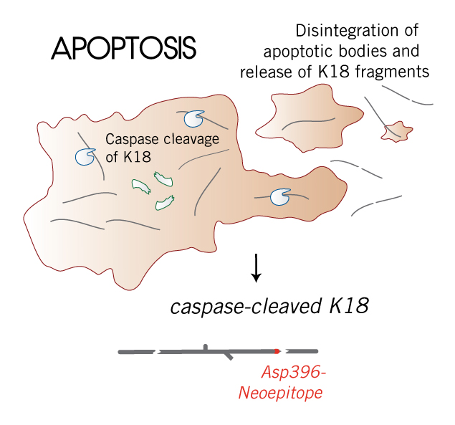

Slide 2
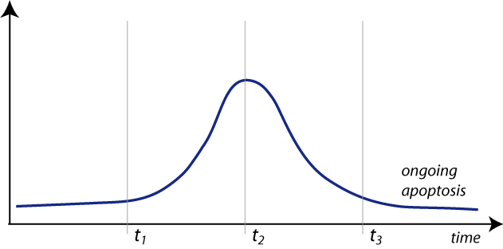
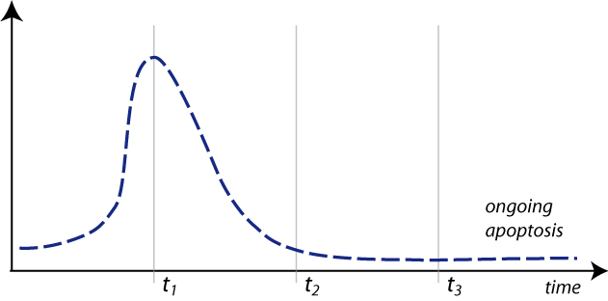
Slow induction of apoptosis
Rapid induction of apoptosis
Apoptosis in Epithelial Cells Occurs at Various Rates Depending on Stimuli
Examples of apoptosis induction with different kinetics measured by competing technologies such as TUNEL or Annexin V

Slide 3
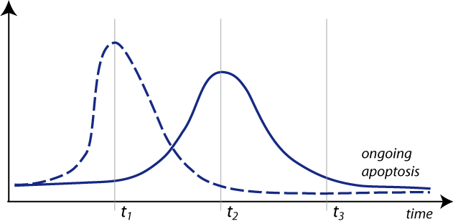
Slow induction of apoptosis
Rapid induction of apoptosis
The time point of the measurement is crucial:

Slide 4
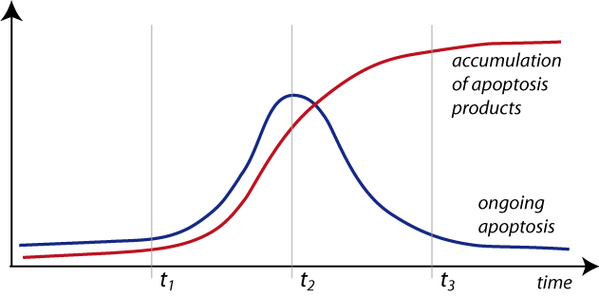
Slow induction of apoptosis
Rapid induction of apoptosis
Measurement of an accumulated apoptosis product eliminates the need for multiple time points

Slide 5
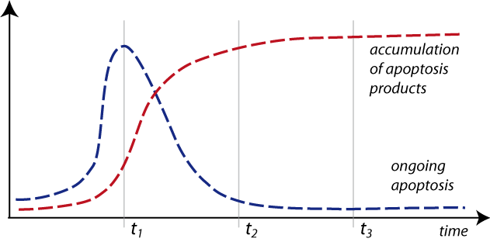
Slow induction of apoptosis
Rapid induction of apoptosis
An accumulated apoptosis product is measured by the M30 CytoDeath™ and M30 Apoptosense® ELISAs:

Slide 6
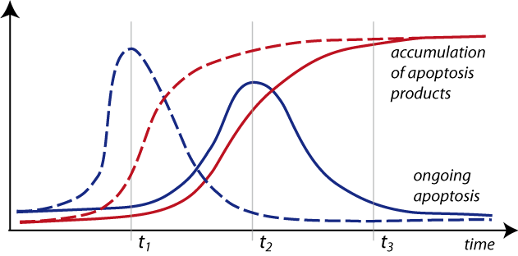
Slow induction of apoptosis
Rapid induction of apoptosis
Only one late time point is needed with the M30 CytoDeath™ ELISA and M30 Apoptosense® ELISA, as well as the M65 Epideath® (for apoptosis and necrosis)

