Slide 1


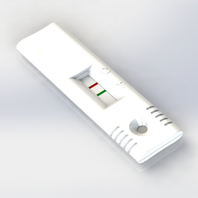
NEATstik®
Introducing the NEATstik®
Lateral Flow Test for Neutrophil Elastase, providing qualitative results for respiratory disease research.
*Research use only in the U.S. and Canada. Not for diagnostic procedures.
ML-00-01023

Slide 2
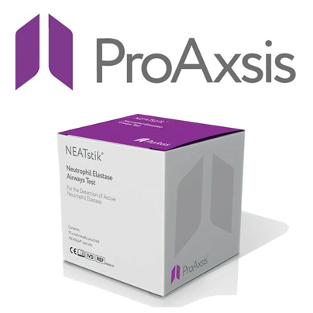
Introducing NEATstik®
  NEATstik® is a unique test format created through use of advanced patented ‘ProteaseTag’ technology and scientific expertise
  It is a lateral flow test for monitoring active Neutrophil Elastase, a key biomarker of lung infection and inflammation, in fresh sputum
  It Includes a control line (C), to establish the strip is working effectively and to detect the conjugate, and a Test line (T) consisting of an antibody which detects active NE in the sample
  A 10 minute test time allows the test to be performed with rapid results
  A solid test line signifies high levels of Neutrophil Elastase (>8 ug/mL)

Slide 3
Support for Active NE as a
Lung Disease Biomarker

Slide 4
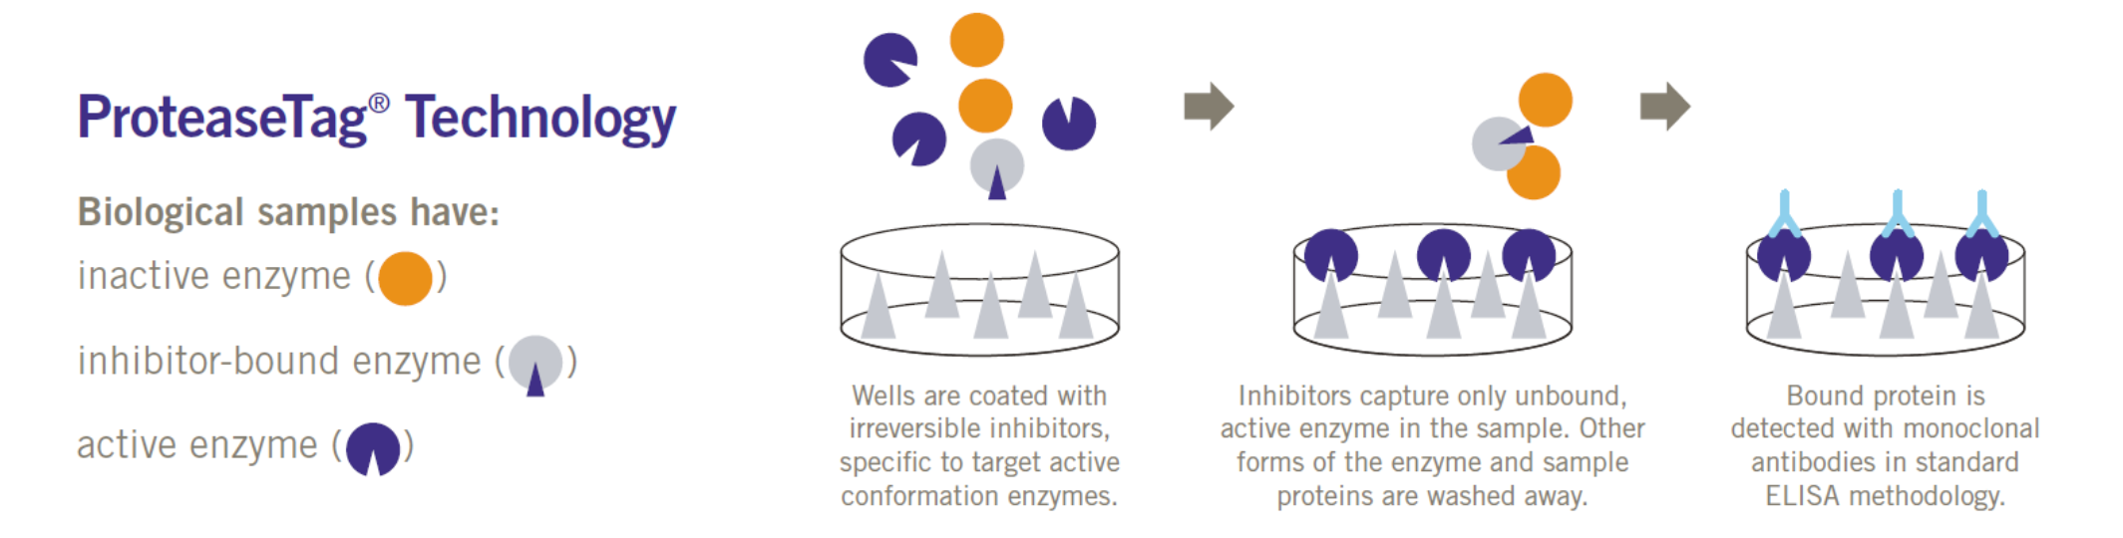
ProteaseTag® Principle

Slide 5
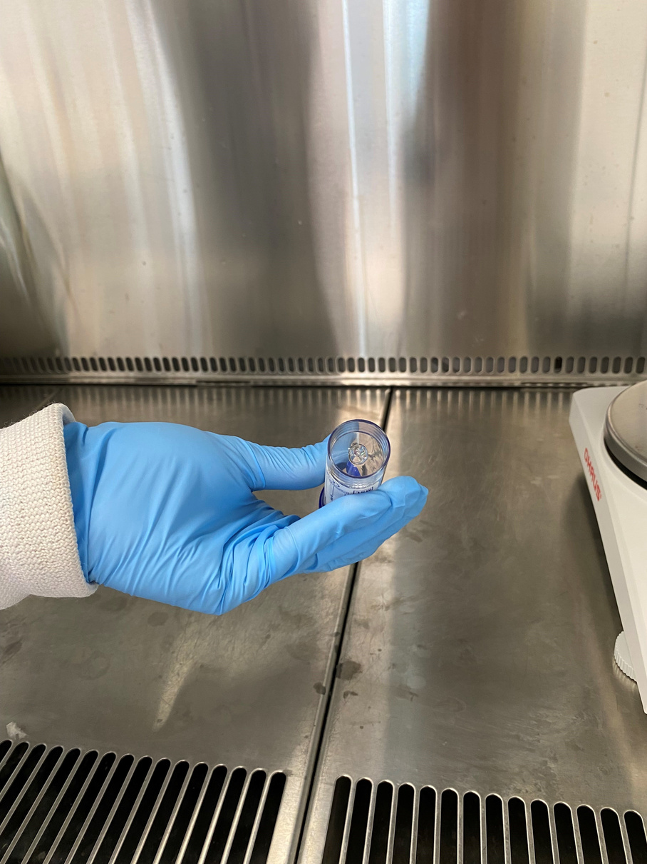
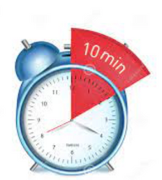
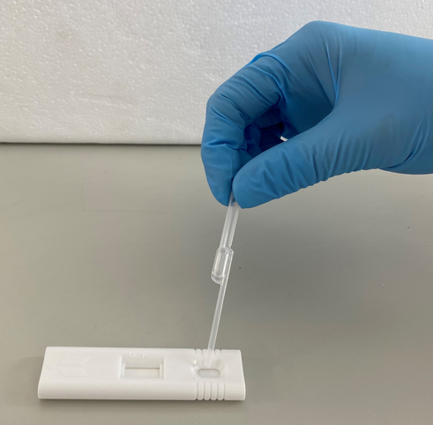
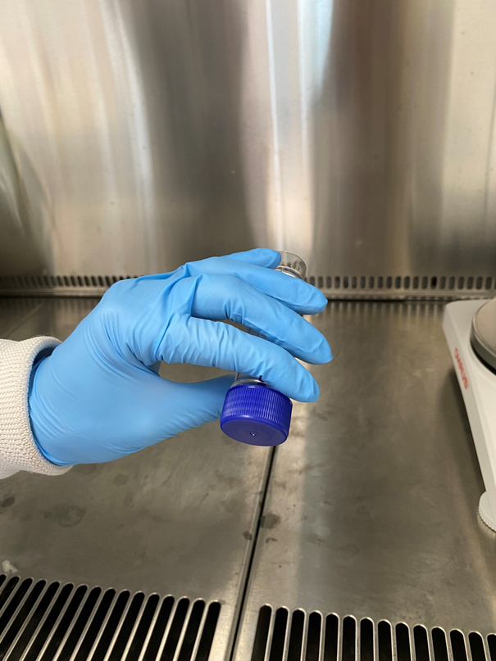
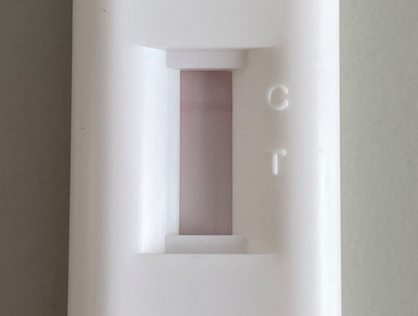
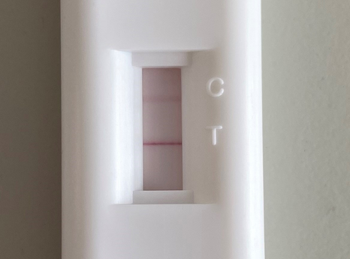
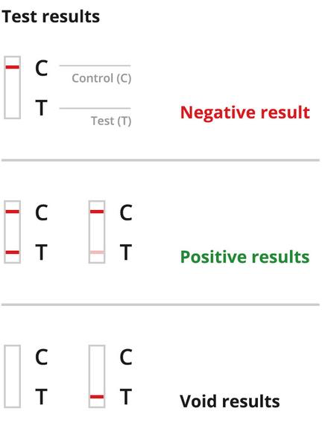


1. Dilute fresh sputum in a collection pot and mix
2. Apply sputum to sample well
3. Wait 10 minutes
4. Read NEATStik® result
POSITIVE
T line is visible. This indicates further intervention is required
NEGATIVE
T line is not visible. This indicates NE levels that are low.
POSITIVE
T line is visible. This indicates high NE activity levels.
(INVALID)

Slide 6
Clinical Study using NEATstik®:
NE activity assay correlates with bronchiectasis severity, airway infection and risk of exacerbation
  Severity of disease, airway infection from sputum culture and exacerbations over the 12 months following sputum sampling were recorded
  Sputum samples from 174 participants with stable bronchiectasis enrolled in the UK (Dundee), Spain (Barcelona) and Italy (Milan) study
  Active NE levels were assessed with both the ProteaseTag® Active NE Immunoassay and NEATstik® (Neutrophil Elastase Airways Test Stik, POCT).

Slide 7
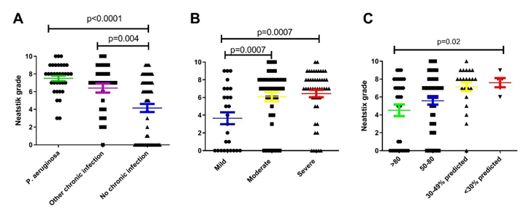
  Compared to participants without chronic infection, those with P. aeruginosa had significantly higher NE activity (Figure A). High active NE levels measured by NEATstik® were associated with increased bronchiectasis severity using the bronchiectasis severity index (Figure B; p=0.0007) and lower FEV1 (Figure C; p=0.02)

Slide 8
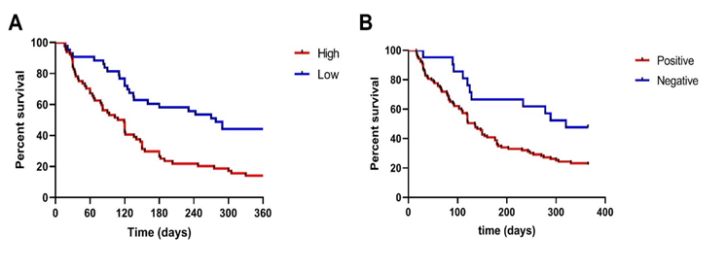
  High active NE levels measured by NEATstik® were predictive of future exacerbations and associated with a significant increase in exacerbation frequency (p<0.0001). The median time to next exacerbation for participants with the highest active NE levels was 113 days compared to 278 days for those with lower levels (Figure A, Hazard ratio = 2.40; p=0.0001).

Slide 9
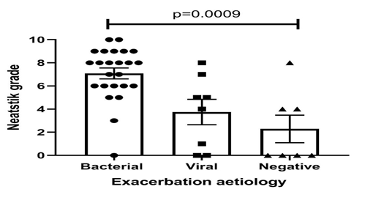
  Bacterial exacerbations were associated with higher active NE levels, thus potentially enabling the identification of participants who may be most likely to respond to antibiotic therapy.

Slide 10

NEATstik®
A Point-of-Care Test for Neutrophil Elastase
Results in 10 minutes for quick results
  Detects active Neutrophil Elastase (NE) in sputum at the point of care
  Reliable results within 10 minutes
  Internal Quality Control ensuring high quality performance
References:
1. Lonergan et al. Blood neutrophil counts are associated with exacerbation frequency
and mortality in COPD. Respiratory Research 2020: 21;166
2. Chalmers et al. Neutrophil Elastase Activity is associated with exacerbations and lung
function decline in Bronchiectasis. Am J Resp Crit Care Med 2017: 195;10:1384
3. Shoemark et al. A point-of-care neutophil elastase activity assay identifies bronchiectasis
severity, airway infection and risk of exacerbation. Eur Resp J 2019: 53;1900303

